Slide 1
Evaluating Register File Size
in ASIP Design
Manoj Kumar Jain
M. Balakrishnan
Indian Institue of Technology
Delhi, India
Lars Wehmeyer
Stefan Steinke
Peter Marwedel
University of Dortmund
Germany

Slide 2
Overview
Introduction
Experimental Setup
Methodology and Results
Analysis
Conclusion

Slide 3
Application Specific
Instruction Set Processors
Designed for specific application
Exploits special characteristics to meet the desired constraints
Efficient for applications like digital signal processing, automatic control systems, cellular phones

Slide 4
GPP-ASIP-ASIC
 | GPP | ASIP | ASIC
Performance | Low | High | Very High
Flexibility | Excellent | Good | Poor
HW Design Effort | Nil | Large | Very Large
SW Design Effort | Small | Large | Nil
Power | Large | Medium | Small
Reuse | Excellent | Good | Poor
Markets | Very Large | Relatively large | Small
Cost | Mainly on SW | S-O-C | Volume sensitive

Slide 5

Flow Diagram of a typical
ASIP Design Methodology
Application &
Design Constraints
Application Analysis
Architectural Design Space Exploration
Instruction Set
Generation
Code Synthesis
Hardware Synthesis
Object Code
Processor Description

Slide 6
Objectives
Study the effect of change in register file size on - Power - Performance - Code Size

Slide 7
Experimental Setup
Benchmark
Suite
encc
Compiler
Instruction Set
Simulator
Register File
Size
Trace Data

Slide 8
encc Compiler Environment
C Code
encc
assembly
Assembler &
Linker
executable
energy
database
profiling
information
trace
analyzer
trace file
ISS

Slide 9
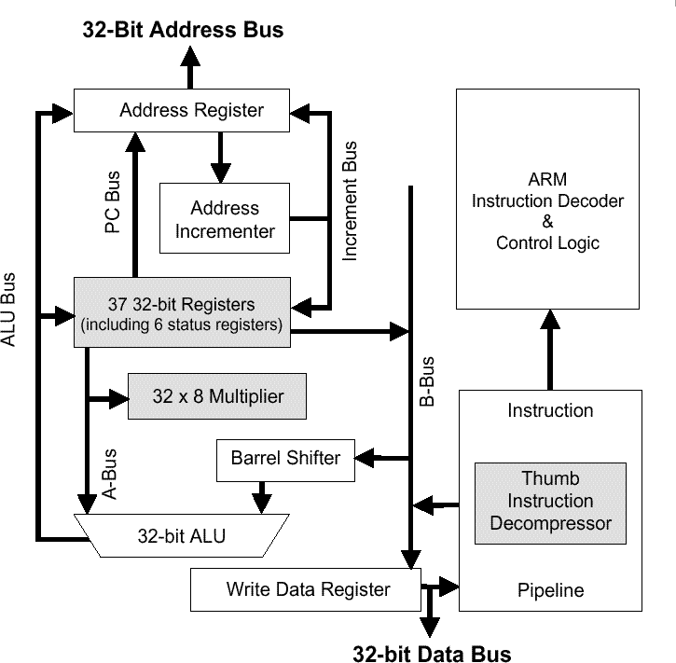
ARM7TDMI processor
Features:
32 Bit RISC
16 GP Registers
ALU, Multiplier, Shifter
2 Instruction Sets:
  ARM & THUMB
Evaluation Board:
4 KB On-Chip Memory
512 KB External RAM

Slide 10
Benchmark Suite
DSP Algorithms: biquad_N_sections
lattice_init
matrix-mult
Media Application: me_ivlin
Standard Sorting Algorithms: bubble_sort
heap_sort
insertion_sort
selection_sort
http://www.cse.iitd.ernet.in/~manoj/research/benchmarks.html

Slide 11
Power Model
Based on Tiwari’s model
Consider processor power and memory Power based on actual measurements
Power models associated with each instruction for
Two different configurations
Off-chip data and instructions
P_{total(inst)} = P_{cpu(inst)} + P_{offchip(read,16)}+ P_{offchip(read/write,width)}
On-chip instruction and off-chip data
P_{total(inst)} = P_{cpu(inst)} + P_{onchip(read,16)}+ P_{offchip(read/write,width)}

Slide 12
Assumptions
Processor cycle does not change with number of registers
Power consumption by each instruction does not change significantly with the change in the number of registers

Slide 13
Methodology
Steps to generate the data:
Generate code using encc
Evaluate code quality
  Static: analysis of assembly code
  Dynamic: analysis of trace generated by ISS
Change number of registers in the
  compiler configuration file
Differences in code quality caused by spilling

Slide 14
Results
Range Number of registers 3 to 8
Memory configurations
- only off chip
- on-chip instruction off-chip data
Results collected
- number of instructions executed
- number of cycles
- ratio of spilling instructions (static)
- power consumption
- energy consumption

Slide 15
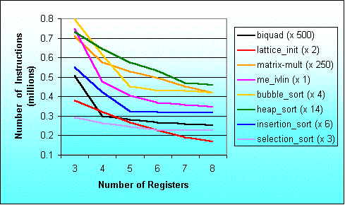
Number of executed instructions

Slide 16
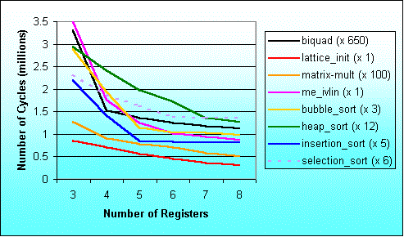
Number of Cycles
(off-chip memory)

Slide 17
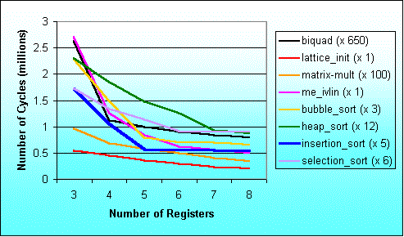
Number of Cycles
(on-chip instr. Off-chip data)

Slide 18
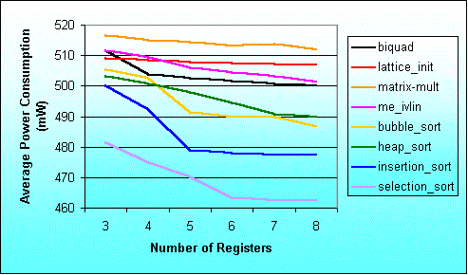
Average power consumption
(off-chip memory)

Slide 19
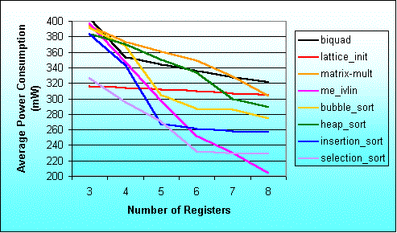
Average power consumption
(on-chip instr. off-chip data)

Slide 20
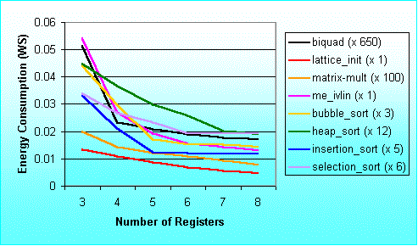
Energy Consumption
(off-chip memory)

Slide 21
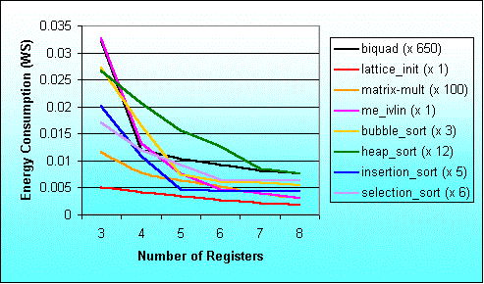
Energy Consumption
(on-chip instr. Off-chip data)

Slide 22
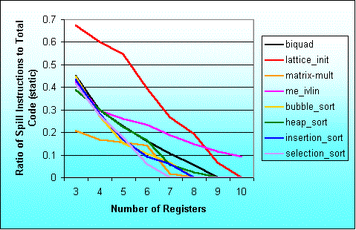
Ratio of spill instructions to total static code size

Slide 23
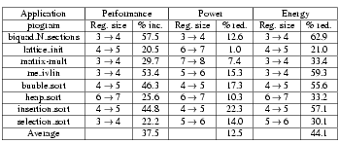
Maximum variation in results

Slide 24
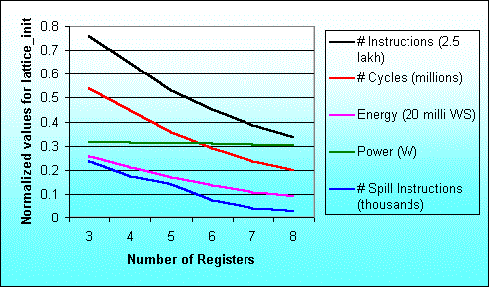
Results for the program lattice_init

Slide 25
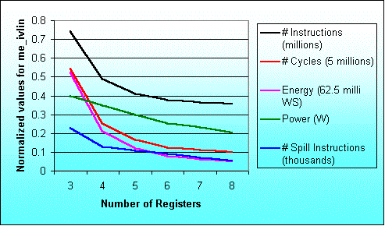
Result for the program me_ivlin

Slide 26
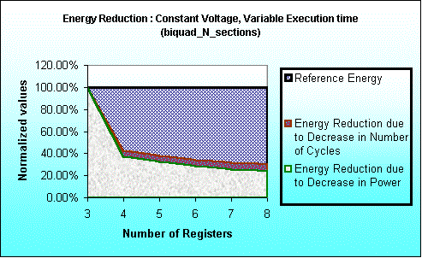
Time saving and Power saving contributions in Energy Saving

Slide 27
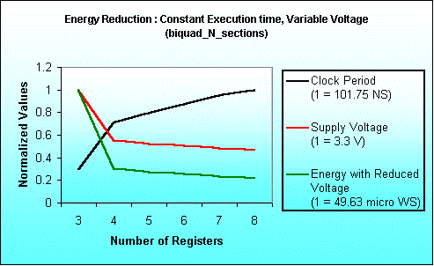
Energy Saving due to
Voltage Scaling
Notes:
Here we have assumed total execution time as constant.
To keep execution time as constant when execution requires lesser number
of cycles we have increased the clock period.
With the increased clock period we can reduce supply voltage.
For estimating supply voltage with varying clock period we had referred
The paper titled “Low Power CMOS Digital Design” – A.P Chandrakasan et al
IEEE J. Solid-State Circuits, Vol. 27, No. 4, pp. 473-484, April 1992.
With this estimated voltage we have calculated Energy.
Since Energy is product of Average Power Consumption and Execution time,
here Execution time is constant and
Power depends quadratically on Voltage.
Keeping these facts into consideration we have computed
Energy Consumption.

Slide 28
Conclusion
Studied results for number of inst. executed cycles, spilling, power and energy consumption for ARM7TDMI processor. Similar results for LEON processor.
Range of number of registers 3 to 8.
Single increase in number of registers results in up to 57.5% performance improvement and 62.9% reduction in energy consumption.

Slide 29
Future work
Identify and extract application parameters to assist early estimation of optimal number of registers.
Consider effect of changing number of registers on instruction encoding and instruction bit-width

Slide 30
References
Ghazal, N. et al “Retargetable estimation scheme for DSP architecture selection” ASP-DAC 2000. pp. 485-489.
Gupta T.V.K. et al “Processor evaluation in an embedded system design environment” VLSI 2000. pp. 98-103
http://www.arm.com/
Jain M.K., Balakrishnan M. Anshul Kumar “ASIP Design Methodologies: Survey and Issues” to appear in VLSI 2001.
http://ls12-www.cs.uni-dortmund.de/~leupers/lanceV2/lanceV2.html
Sato J. et al “An integrated design environment for application specific integrated processor” ICCAD 1991. pp. 414-417.
Tiwari V. et al “Power analysis of embedded software” ICCAD 1994. pp. 384-390.

Slide 31
Thanks

